Slide 1

CSCI 4502/5502
Data Mining - Fall 2023 - Lecture 21
Ravi Starzl, PhD

Slide 2
1
Introduction
Systems: Mobile/wearable/IoT sensing
2
Data-driven Scientific Discovery and Ubiquitous Computing: Systems, Algorithms, Applications
Algorithms: Data management & data analysis
3
Applications: Scientific discovery & ubiquitous computing
4
5
Conclusions & future directions
Ravi Starzl, PhD - Data Mining Fall 2023

Slide 3
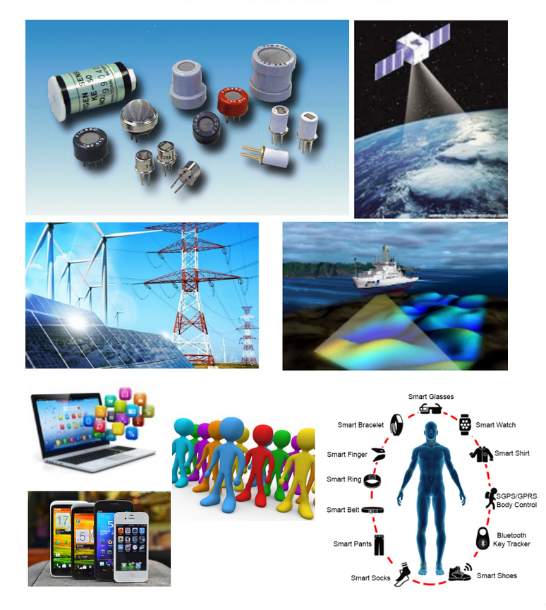
The Digital Universe
Explosive growth
Data collection, transfer, storage, sharing , analysis
Diverse application domains
scientific discovery
people’s daily life
Ravi Starzl, PhD - Data Mining Fall 2023
Notes:
The digital data universe is expanding at an unprecedented rate, driven by the proliferation of internet-connected devices, the rise of social media, and the Internet of Things (IoT). Data collection is now more widespread and accessible, facilitated by various technologies including sensors, online platforms, and user-generated content. This growth is further accelerated by advancements in network technologies, such as 5G and fiber-optic communications, enabling faster and more efficient data transfer.
Data storage has evolved significantly, transitioning from physical servers to more advanced cloud storage solutions, though it continues to face challenges like the need for high capacity and secure storage options. Sharing of data has become easier with the development of new platforms and protocols, including APIs and data exchange standards, but this raises important considerations regarding data privacy and security.
Data analysis has become more sophisticated with the advent of tools like machine learning and AI, turning massive datasets into actionable insights. This explosion of data is impacting diverse domains, from healthcare and finance to environmental monitoring and urban planning, making data-driven strategies increasingly crucial for decision-making.
In the realm of scientific discovery, the availability of vast amounts of data is fueling research and leading to breakthroughs in various fields like genomics, astrophysics, and climatology. It enables more accurate and comprehensive scientific models and simulations.
On a societal level, the growth of digital data profoundly affects everyday life, offering personalized services, smart home technologies, and advanced digital entertainment, while also bringing to the fore issues like privacy concerns and the digital divide.
Finally, the concept of the Digital Universe encompasses all digital data created, captured, and replicated worldwide. Looking forward, this trend poses both opportunities and challenges, highlighting the need for sustainable and responsible data management strategies to navigate the future of this ever-expanding digital landscape.

Slide 4
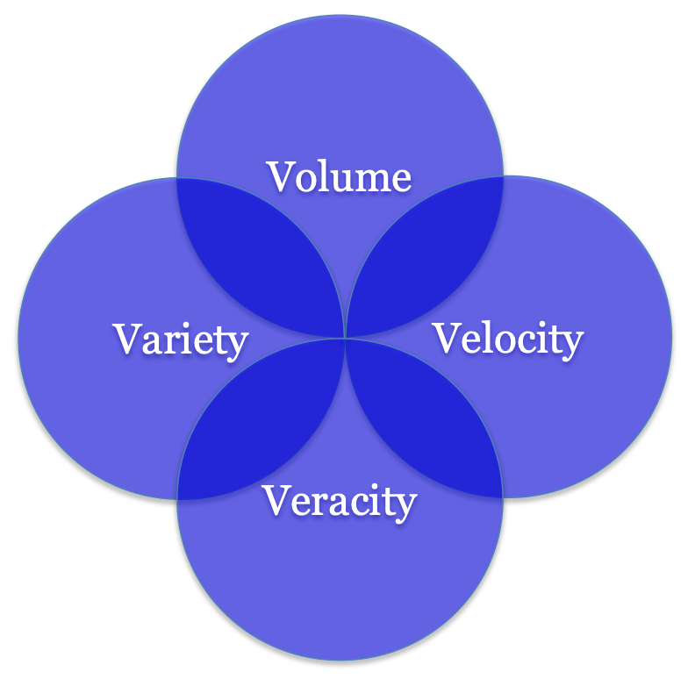
Big Data: The 4Vs
Value
Making sense of data
Limited human capabilities
Drowning in data, yet starving for knowledge
Ravi Starzl, PhD - Data Mining Fall 2023
Notes:
Big Data is often characterized by the 4Vs: Volume, Velocity, Variety, and Veracity. However, focusing on the Value aspect, it's crucial to understand that the true potential of Big Data lies not just in its size but in our ability to extract meaningful insights from it. While the sheer volume of data available today is overwhelming, human capacity to manually analyze this data is limited. This paradox, often described as "drowning in data, yet starving for knowledge," highlights the critical need for advanced analytical tools and techniques. Efficient data processing and analysis methods, such as machine learning and artificial intelligence, are essential in making sense of this vast amount of information. The ultimate goal is to transform this data into valuable knowledge that can inform decision-making and drive innovation across various fields. It’s not just about having access to big data but being able to discern its value and apply it effectively.

Slide 5
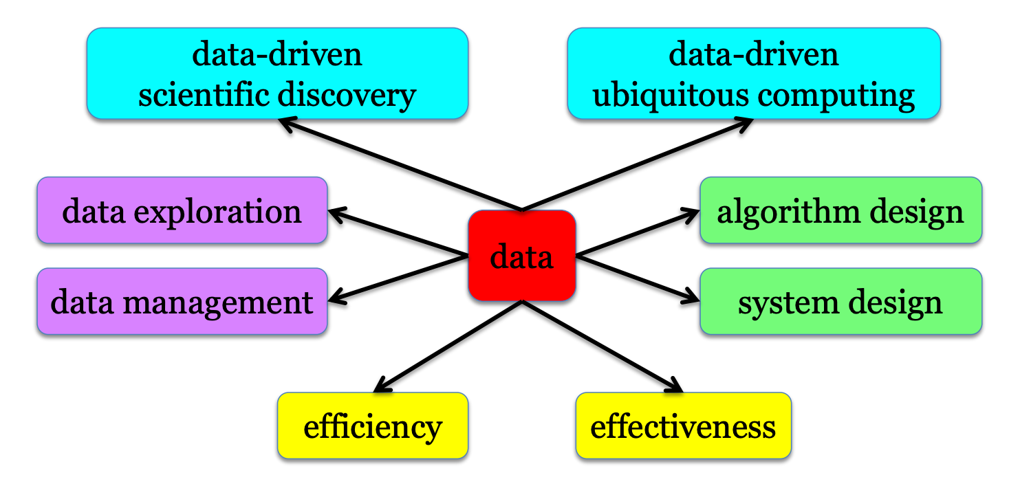
Research Overview
interdisciplinary
Ravi Starzl, PhD - Data Mining Fall 2023
Notes:
The research overview emphasizes its interdisciplinary nature, highlighting the integration of multiple fields to address complex questions or problems. This approach combines methods, theories, and perspectives from different disciplines, creating a comprehensive framework for research. By transcending traditional boundaries, interdisciplinary research fosters innovation and novel insights, addressing challenges that are too complex for a single-field approach. It's crucial in areas like environmental studies, where science, economics, and policy intersect, or in health sciences, where biology, technology, and sociology converge. This collaborative, holistic approach is increasingly essential in our interconnected and multifaceted world, where solutions often require a synthesis of diverse expertise.

Slide 6
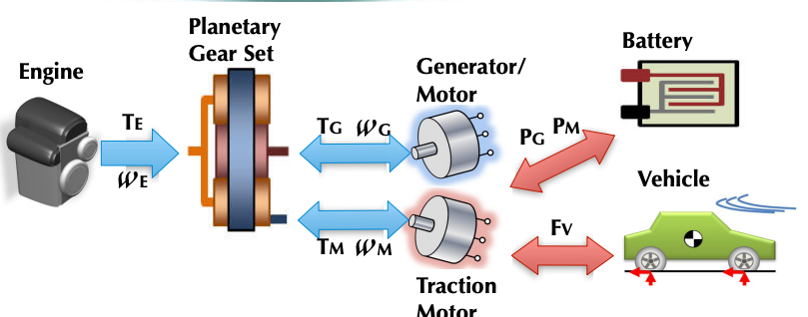
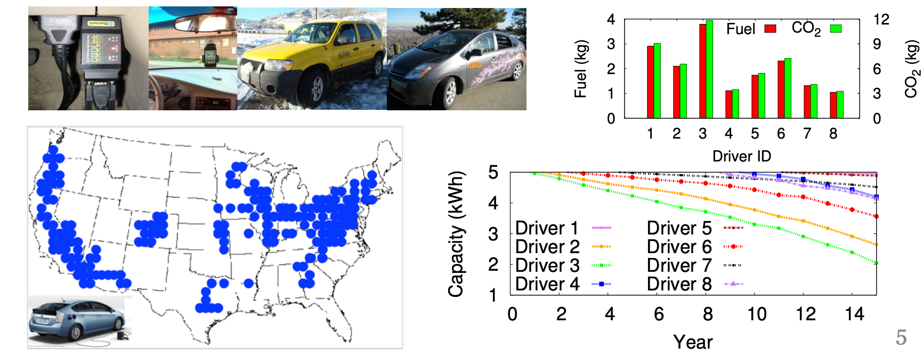
Full-stack Data Analytics
• E.g., Plug-in Hybrid Electric Vehicles
Ravi Starzl, PhD - Data Mining Fall 2023
Notes:
Full-stack Data Analytics, when applied to a specific domain like Plug-in Hybrid Electric Vehicles (PHEVs), involves a comprehensive approach that encompasses the entire spectrum of data handling, from collection and storage to analysis and visualization. Here's a breakdown of how this could be applied to PHEVs:
Data Collection: In the context of PHEVs, data collection involves gathering information from various sources. This can include vehicle performance metrics (like battery usage, fuel efficiency, and engine performance), driver behavior data, GPS and routing information, and external environmental data.
Data Storage and Management: With the high volume and variety of data collected, robust storage solutions are necessary. This involves not just securely storing the data but also organizing it in a way that facilitates efficient retrieval and analysis. Technologies like cloud storage and database management systems play a crucial role here.
Data Processing and Analysis: This stage involves cleaning and processing the collected data to make it suitable for analysis. Advanced analytics techniques are then applied to extract insights. For PHEVs, this could involve analyzing driving patterns to optimize battery usage, predicting maintenance needs, or assessing the environmental impact of the vehicles.
Data Visualization and Reporting: The insights gained from data analysis need to be presented in an understandable and actionable format. Data visualization tools are used to create dashboards and reports that can inform decision-making for manufacturers, policy-makers, and consumers.
Integration with Decision-Making Processes: The ultimate goal of full-stack data analytics in the context of PHEVs is to inform and enhance decision-making processes. This could range from helping manufacturers improve vehicle design, aiding governments in creating effective transportation policies, to assisting consumers in maximizing their vehicle's efficiency and lifespan.
Feedback Loop for Continuous Improvement: An essential aspect of full-stack analytics is the creation of a feedback loop, where insights gained from data analysis lead to actions that generate new data, which is then analyzed again. This continuous cycle leads to ongoing improvements and refinements in PHEVs technology and usage.

Slide 7
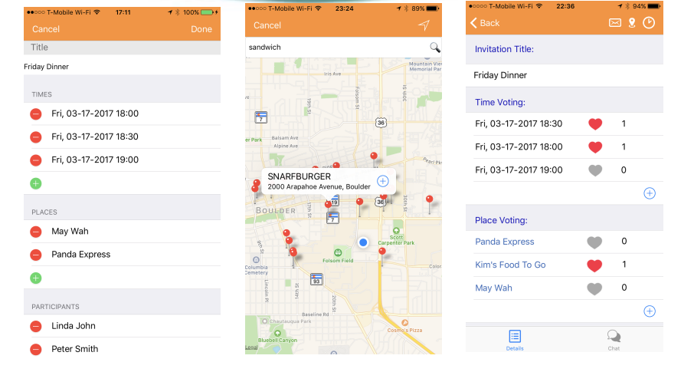
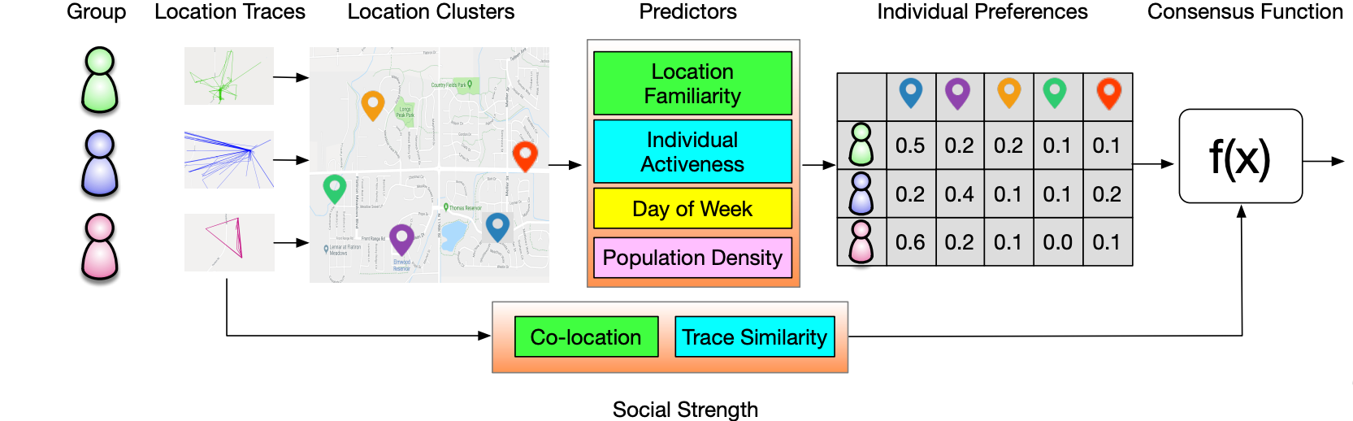
Full-stack Data Analytics
E.g., group event scheduling
OutWithFriendz mobile app
GEVR event venue recommendation
Ravi Starzl, PhD - Data Mining Fall 2023
Notes:
Full-stack Data Analytics for a mobile app like "OutWithFriendz," which focuses on group event scheduling and offers features like GEVR (Group Event Venue Recommendation), involves an end-to-end approach encompassing all aspects of data handling. Here's how it can be structured:
Data Collection:
For an app like OutWithFriendz, data collection would involve user inputs for event scheduling (dates, preferences, locations), user feedback on venues, interaction data within the app, and possibly integration with external calendars or social media platforms.
Data Storage and Management:
Secure and efficient data storage is vital to handle the personal and preference data of users. This could involve using cloud-based databases for scalability and implementing robust data management practices to ensure privacy and data integrity.
Data Processing and Analysis:
Processing the collected data to extract meaningful patterns is crucial. This could involve analyzing user preferences and behaviors to optimize the GEVR algorithm, understanding popular venues, or identifying peak times for app usage.
Advanced analytics and machine learning techniques can be applied to personalize recommendations and improve user experience.
Data Visualization and Reporting:
Visualizing data through dashboards can help the app’s team to monitor user engagement, effectiveness of the venue recommendation algorithm, and overall app performance.
Reports generated from user feedback and usage patterns can guide future app enhancements and marketing strategies.
Integration in App Features:
The insights from data analysis are directly integrated into the app's functionalities. For example, the GEVR feature uses analyzed data to recommend venues based on group preferences, past choices, and other parameters like location and cost.
User experience personalization, based on data-driven insights, can significantly enhance the functionality of the event scheduling feature.
Feedback Loop and Continuous Improvement:
User interactions with the app’s recommendations and scheduling features provide continuous feedback.
This feedback is used to refine algorithms, update features, and ensure the app remains responsive to user needs and preferences.
Data-Driven Decision Making:
Strategic decisions regarding app development, marketing, and user engagement are driven by insights derived from data analysis.
Understanding user behavior and preferences helps in tailoring the app to better meet user needs and improve overall satisfaction.

Slide 8
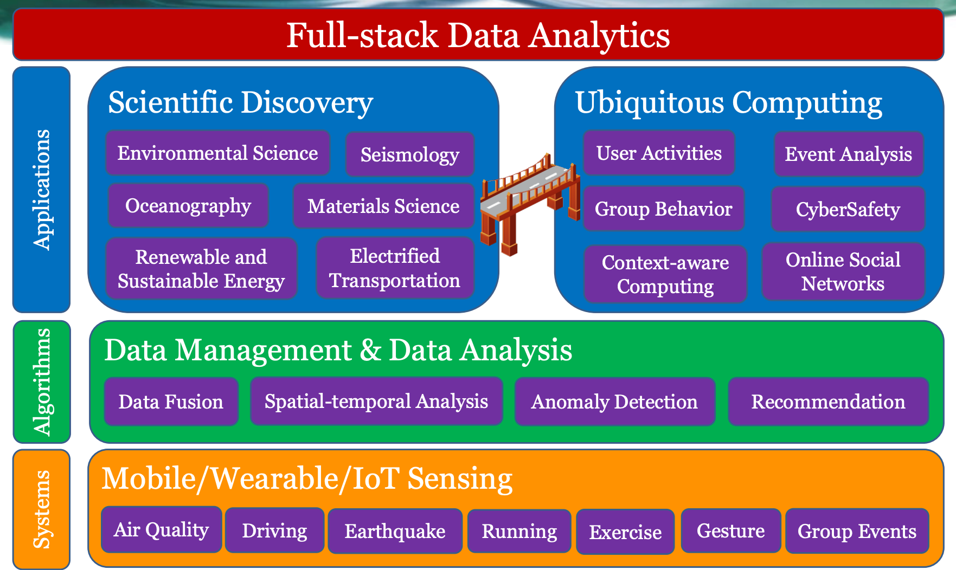
Ravi Starzl, PhD - Data Mining Fall 2023

Slide 9
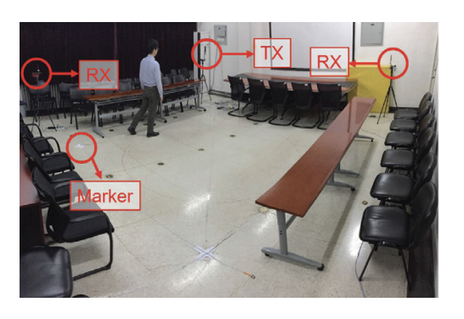
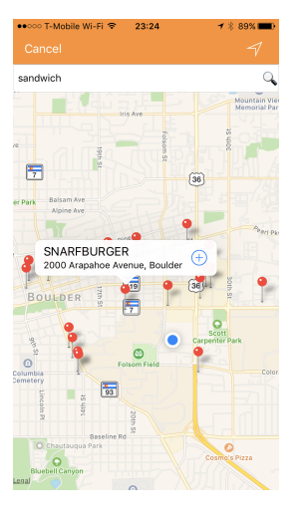
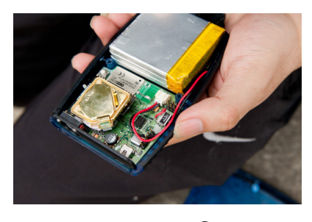
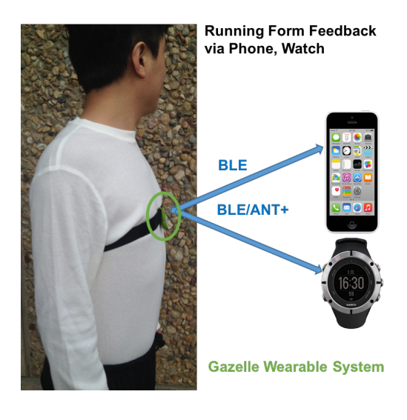
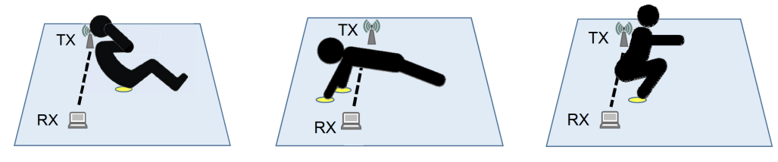
Mobile/Wearable/IoT Computing
Air quality
Driving
Earthquake
Running
Exercise
Gesture
Group events
Ravi Starzl, PhD - Data Mining Fall 2023
Notes:
Mobile, Wearable, and IoT (Internet of Things) Computing are rapidly evolving fields that leverage interconnected devices to enhance various aspects of daily life. Here's an overview of how these technologies can be applied to different areas:
Air Quality Monitoring:
Mobile and IoT devices equipped with environmental sensors can monitor air quality in real-time.
Users can receive updates and alerts on their mobile or wearable devices about the air quality in their immediate environment or in designated locations, facilitating health-conscious decisions.
Driving Assistance:
Integration of IoT technology in vehicles and mobile apps can enhance driving experiences.
Features might include real-time traffic updates, route optimization, vehicle diagnostics, and even alert systems for driver safety based on driving patterns and external conditions.
Earthquake Detection and Alert Systems:
Wearable and mobile devices can be part of an interconnected network that detects seismic activities.
Early warning systems can notify users of impending earthquakes, giving them precious time to seek safety.
Running and Exercise Tracking:
Wearable devices like fitness trackers and smartwatches can monitor various aspects of running and exercise, including distance covered, pace, heart rate, and calories burned.
This data can be synced to mobile apps for detailed analysis and personalized fitness recommendations.
Gesture Recognition and Control:
IoT devices and wearables can be equipped with sensors to recognize and interpret human gestures.
This technology can be used for hands-free control of various devices or for interactive gaming and virtual reality experiences.
Group Events Coordination:
Mobile apps can leverage location data and user preferences to facilitate group event planning.
Features might include collaborative scheduling tools, event reminders, and even real-time location sharing for easier coordination.

Slide 10
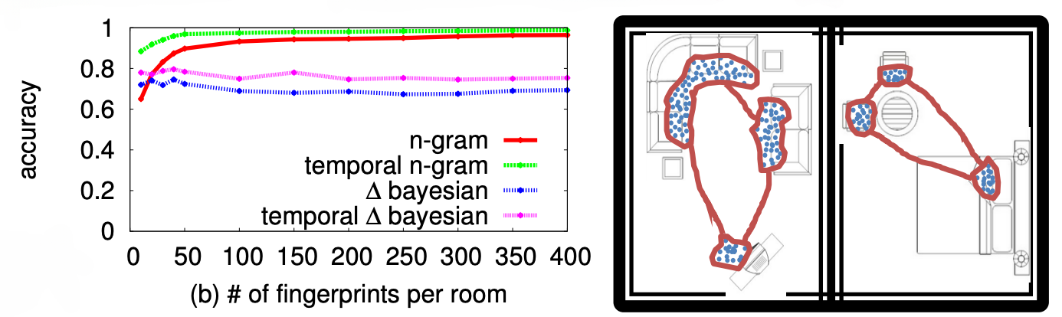
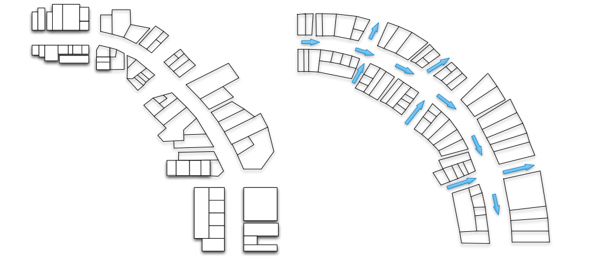
Wi-Fi Sensing: Received Signal Strength (RSS)
Indoor room localization
Personalized air pollution risk analysis
Supervised model
Unsupervised model
Automated floorplan construction
Ravi Starzl, PhD - Data Mining Fall 2023
Notes:
Wi-Fi sensing using Received Signal Strength (RSS) is a technique that leverages the signal strength of Wi-Fi networks for various applications. Here's how it can be applied in different contexts:
Indoor Room Localization:
Utilizes the RSS from Wi-Fi networks to determine a device's location within a building.
By measuring the signal strength from multiple Wi-Fi access points, algorithms can triangulate the position of a device, useful for indoor navigation, locating assets, or in smart home setups.
Personalized Air Pollution Risk Analysis:
Integrates Wi-Fi sensing with environmental data to assess personal exposure to air pollution.
By correlating a user’s indoor location (identified using RSS) with external pollution data, the system can provide personalized air quality assessments and recommendations.
Supervised Model in Wi-Fi Sensing:
Involves training a model with labeled data where the RSS values are mapped to specific locations or conditions.
This model can then predict the location or condition (like air quality levels) for new RSS readings. It requires an initial setup where data is collected and labeled accurately.
Unsupervised Model in Wi-Fi Sensing:
Unsupervised models identify patterns or clusters in the RSS data without pre-labeled training data.
This approach can be used to detect anomalies in Wi-Fi networks or to understand spatial patterns in an environment, like the most frequented areas in a building.
Automated Floorplan Construction:
Utilizes RSS data to map out the layout of a building or a room.
By moving around in a space and recording the RSS values from various points, algorithms can construct a floorplan or identify the locations of walls and obstacles.

Slide 11
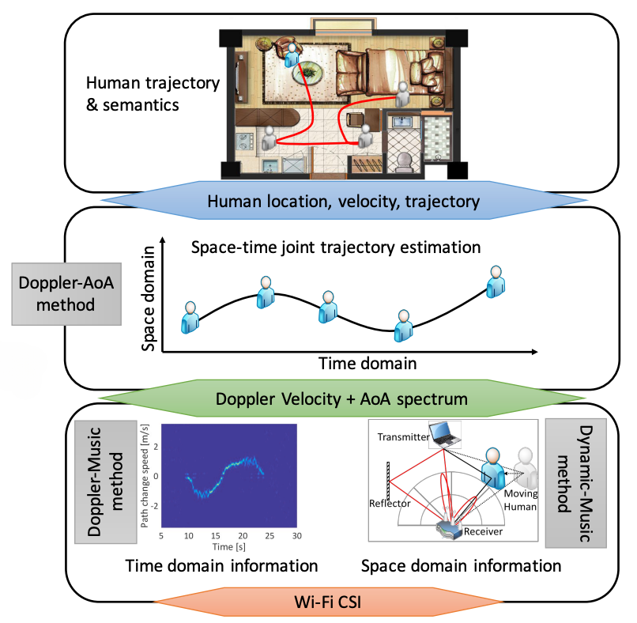
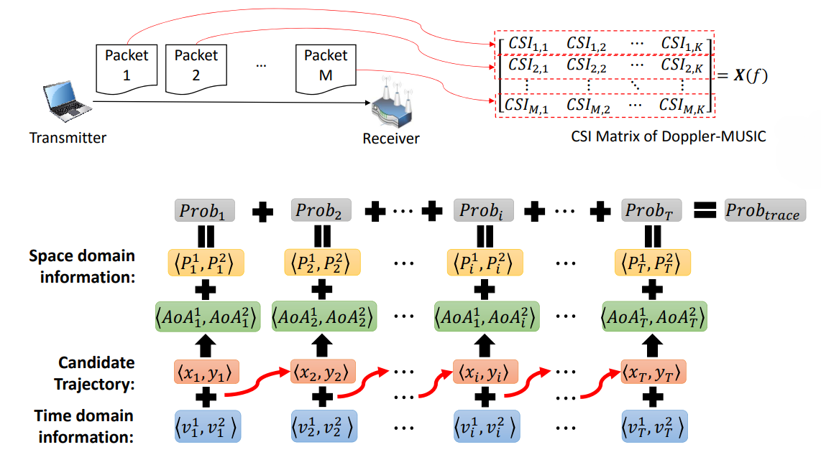
Wi-Fi Sensing: Channel State Information (CSI)
• Device-Free Indoor Human Tracking
Ravi Starzl, PhD - Data Mining Fall 2023
Notes:
Wi-Fi Sensing using Channel State Information (CSI) is a more advanced approach compared to traditional RSS (Received Signal Strength) methods, offering finer granularity in sensing the environment. Here's an overview of how CSI can be utilized for device-free indoor human tracking:
High-Resolution Sensing with CSI:
Unlike RSS, CSI provides detailed information about the Wi-Fi signal, including its amplitude and phase across different subcarriers. This detailed data allows for a more accurate analysis of how the Wi-Fi signal is affected by the environment, especially by moving objects like humans.
Device-Free Indoor Human Tracking:
CSI-based Wi-Fi sensing can track human movement without requiring any device to be carried by the person being tracked. It works by analyzing how human movement affects the characteristics of the Wi-Fi signal in an indoor space.
As people move, they cause changes in the wireless signal’s propagation pattern (such as multipath fading), which can be detected and interpreted to track their location and movement.
Applications:
Such tracking systems can be used in various applications, including smart home automation (e.g., adjusting lighting and heating based on occupancy), security and surveillance (e.g., detecting intruders), healthcare (e.g., monitoring the movements of elderly individuals for safety), and retail analytics (e.g., tracking customer movement patterns within a store).
Advantages Over Traditional Methods:
CSI-based tracking is more accurate than RSS-based methods and can provide finer resolution in detecting movements.
It is also less intrusive as it doesn't require individuals to wear or carry any tracking devices.
Challenges and Limitations:
Despite its advantages, CSI-based Wi-Fi sensing faces challenges such as being affected by environmental factors like walls and furniture, which can distort the signal.
There are also privacy concerns, as continuous monitoring and tracking can be perceived as invasive.

Slide 12
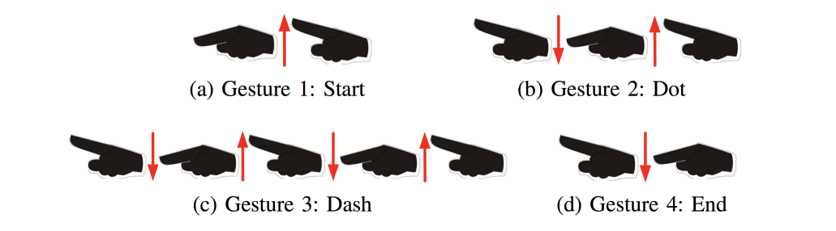
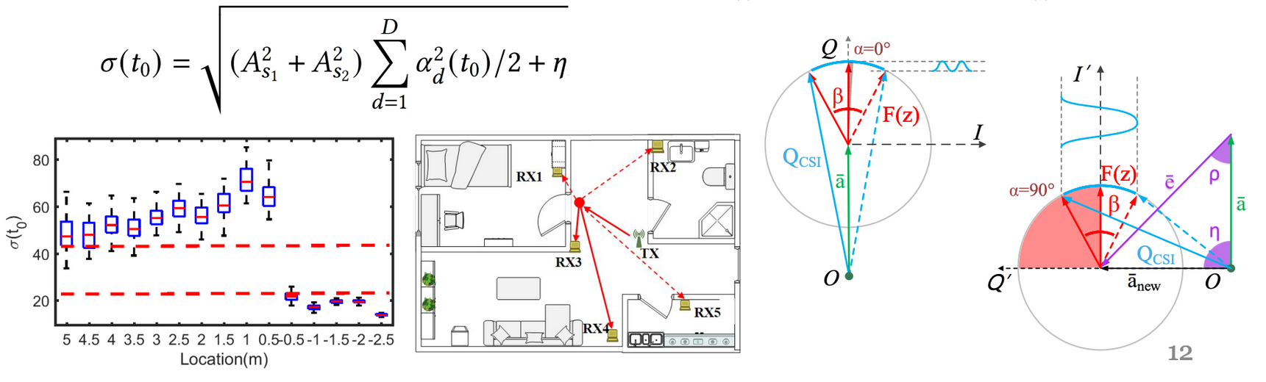
Wi-Fi Sensing: Channel State Information (CSI)
Morse code input
Precise boundary detection
Ravi Starzl, PhD - Data Mining Fall 2023
Notes:
Wi-Fi Sensing using Channel State Information (CSI) can be innovatively applied in various ways beyond conventional tracking and localization. Here are two unique applications: Morse code input and precise boundary detection.
Morse Code Input Using CSI:
CSI can be utilized to develop a system that interprets Morse code input through Wi-Fi signals. This application leverages the fine-grained information that CSI provides about the Wi-Fi signal’s behavior, such as phase and amplitude changes.
A user can input Morse code by performing simple gestures or movements that correspond to dots and dashes. These movements induce changes in the Wi-Fi signals, which the CSI-based system can detect and decode into characters or commands.
This application could be particularly useful in scenarios where traditional input methods are not feasible, such as in smart home environments for users with mobility restrictions, or in situations requiring discreet or hands-free communication.
Precise Boundary Detection:
CSI’s detailed signal information can be used for precise boundary detection in indoor environments. This involves mapping the Wi-Fi signal’s propagation and its interaction with physical boundaries, such as walls and furniture.
By analyzing the disruptions or changes in the Wi-Fi signal as it encounters physical barriers, a CSI-based system can accurately map and define the boundaries of a room or space.
Such precise boundary detection has potential applications in indoor navigation systems, particularly for visually impaired individuals, or in robotics for navigating and understanding indoor environments.

Slide 13
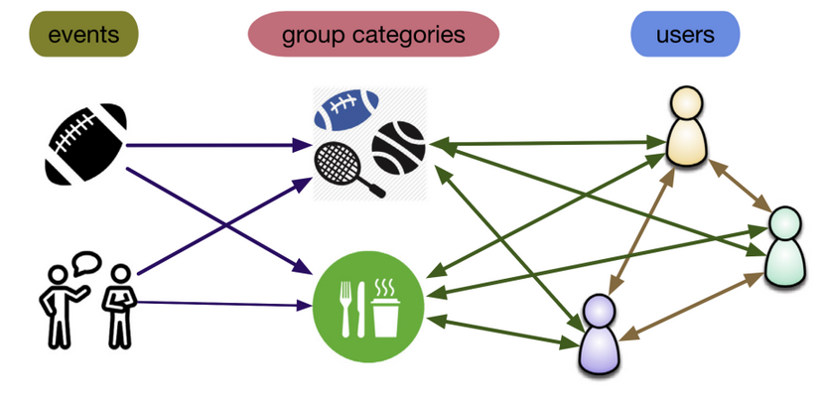
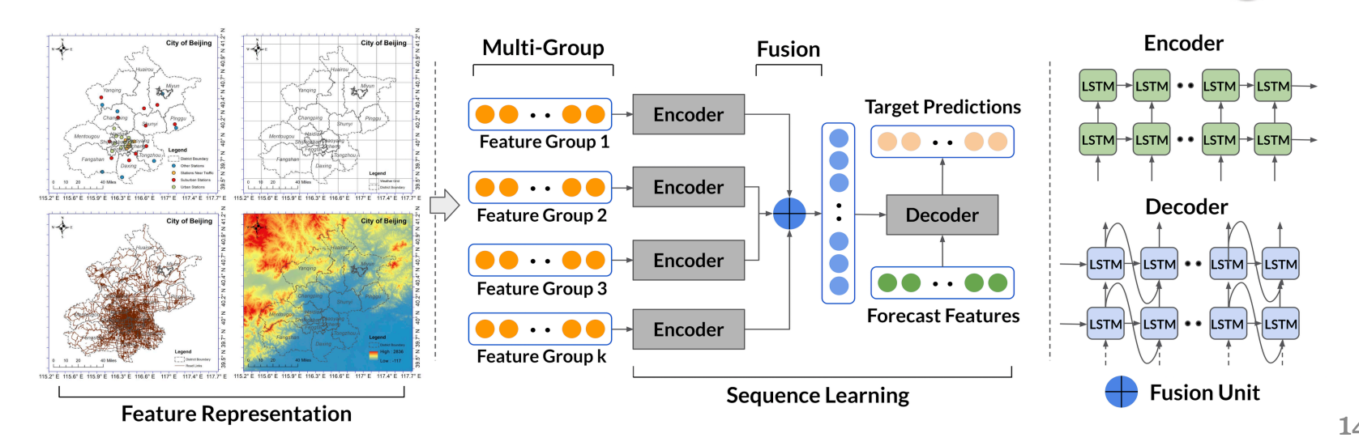
Multi-modal Data Fusion
Mobile, social, content, network
Space, time, sensors, land use, …
Ravi Starzl, PhD - Data Mining Fall 2023
Notes:
Multi-modal Data Fusion involves integrating data from multiple sources and types to provide a more comprehensive understanding or enhanced decision-making capabilities. In the context of mobile, social, content, and network sources, along with spatial, temporal, sensory, and land use data, this approach can be highly insightful. Here's an overview:
Integration of Diverse Data Types:
Mobile Data: This includes data from smartphones and other mobile devices, such as location data, app usage, and communication patterns.
Social Data: Data from social media platforms, including user posts, interactions, network connections, and sentiment analyses.
Content Data: This encompasses data from various content platforms like news sites, blogs, and multimedia content, offering insights into public interests and trends.
Network Data: Data related to network usage and interactions, including internet traffic patterns, connectivity maps, and communication networks.
Adding Dimensions with Space, Time, Sensors, and Land Use:
Space and Time: Geospatial and temporal data provide context to the data collected, revealing patterns and trends based on location and time. For instance, analyzing mobile data with time-stamped geolocation can reveal traffic patterns or population movement trends.
Sensors: Data from various sensors, including environmental sensors, IoT devices, and wearables, contribute to a deeper understanding of the physical world and user behaviors.
Land Use: Integrating land use data, such as urban planning records and satellite imagery, can provide insights into how different areas are used and their impact on mobility, environment, and social dynamics.
Applications of Multi-modal Data Fusion:
Such data fusion can be applied in urban planning for optimizing infrastructure and public services based on population movements and land use patterns.
In marketing, it can help in creating targeted strategies by understanding customer behaviors through social, mobile, and content data.
For environmental monitoring, integrating sensor data with social and mobile data can enhance disaster response or pollution tracking efforts.
Challenges and Considerations:
A key challenge in multi-modal data fusion is managing and integrating heterogeneous data types while maintaining data quality and privacy.
Advanced analytics techniques, like machine learning and data mining, are often required to extract meaningful insights from the fused data.
Future Implications:
As data sources continue to expand and diversify, multi-modal data fusion becomes increasingly critical for extracting valuable insights and making informed decisions in various domains.
It represents a move towards a more interconnected and holistic approach to data analysis, where the sum of combined data is greater than its individual parts.

Slide 14
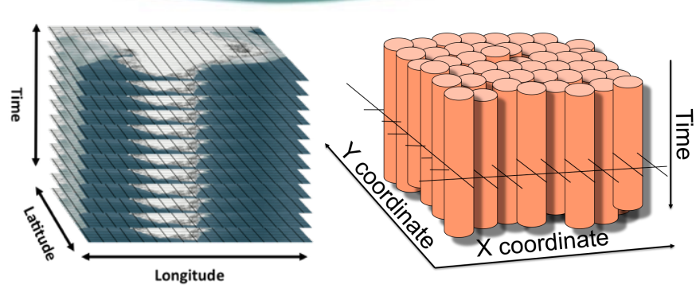
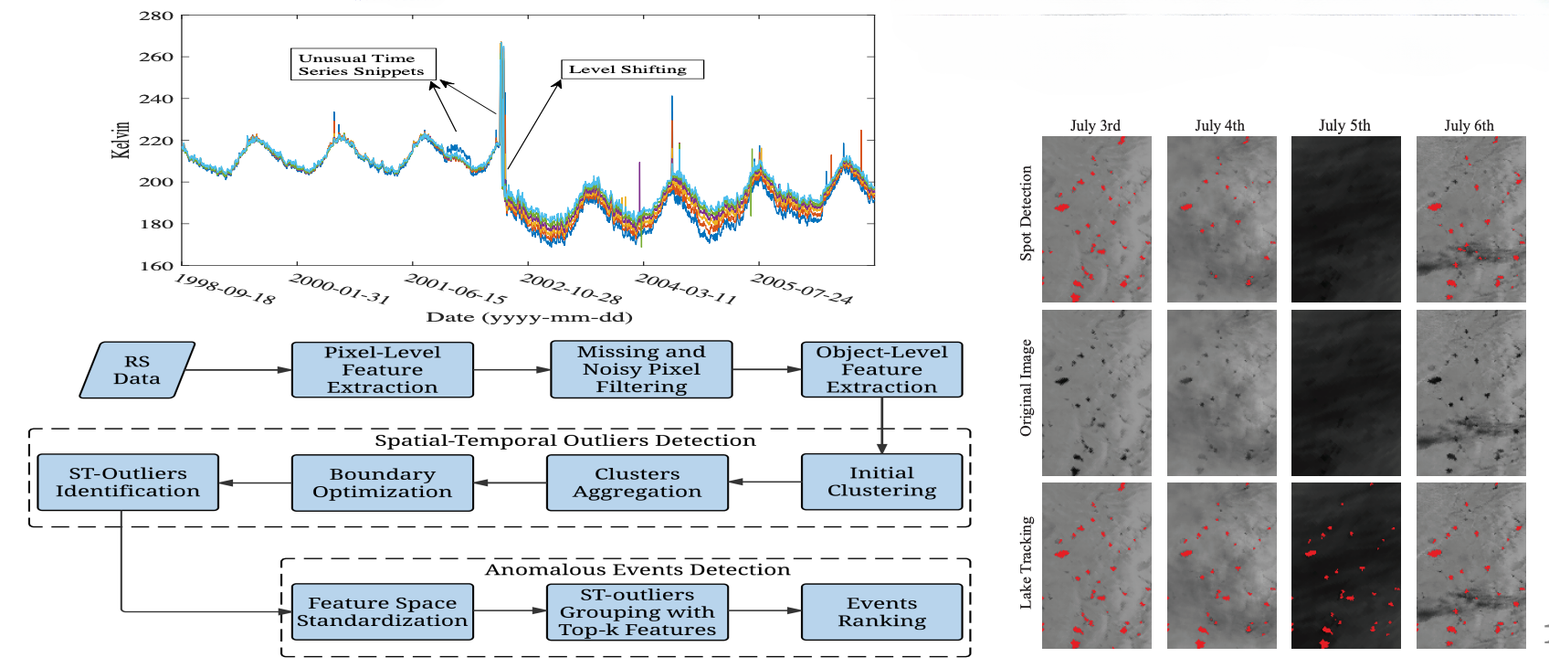
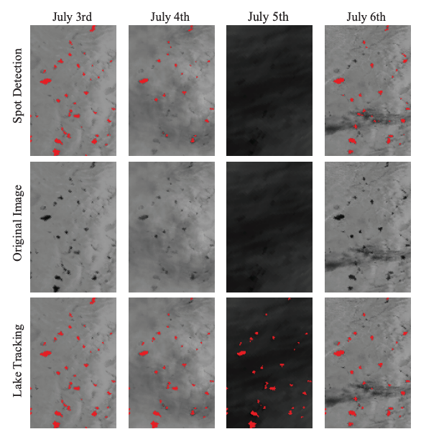
Anomaly
Detection
Remote sensing data
Ravi Starzl, PhD - Data Mining Fall 2023
Notes:
Anomaly detection in remote sensing data involves identifying unusual patterns or observations in data collected from satellites, aircraft, or drones that deviate significantly from the norm. This process is crucial for various applications, from environmental monitoring to security. Here’s an overview:
Understanding Anomalies in Remote Sensing:
Anomalies in remote sensing data are typically patterns or changes that are unexpected or rare compared to the usual state observed in the data. These could be changes in land cover, sudden environmental shifts, or unusual activities.
Detection of these anomalies is important for early warning systems, environmental protection, and even for strategic applications like border security.
Techniques for Anomaly Detection:
Statistical Methods: These involve using statistical models to understand the standard patterns in the data and then identify deviations. Techniques like regression analysis, clustering, or principal component analysis (PCA) are common.
Machine Learning: Supervised learning methods can be used when labeled data is available, training models to recognize both normal and anomalous patterns. Unsupervised learning, like cluster analysis or neural networks, is used when labels are not available.
Deep Learning: Techniques like Convolutional Neural Networks (CNNs) or Autoencoders, which can process and analyze complex and high-dimensional data typical in remote sensing imagery.
Applications of Anomaly Detection in Remote Sensing:
Environmental Monitoring: Detecting changes in land use, unusual vegetation patterns, or water quality issues.
Disaster Response: Early detection of natural disasters like forest fires, floods, or storms.
Agriculture: Identifying issues in crop health or pest infestations.
Urban Planning: Monitoring urban expansion and detecting illegal constructions.
Security and Surveillance: Spotting unauthorized activities or changes in restricted areas.
Challenges in Anomaly Detection:
One of the main challenges is the vast amount of data generated by remote sensing technologies, requiring efficient processing and analysis methods.
Another challenge is the dynamic nature of the Earth’s surface, where changes can be gradual or seasonal, making it difficult to distinguish between normal and anomalous changes.
Ensuring accuracy in anomaly detection also involves dealing with issues like cloud cover, atmospheric conditions, and varying illumination that can affect remote sensing data.
Future Trends:
Integration of multi-source data, like combining satellite imagery with IoT sensor data, for more accurate anomaly detection.
Increasing use of AI and deep learning for automated and real-time anomaly detection in vast and complex datasets.

Slide 15
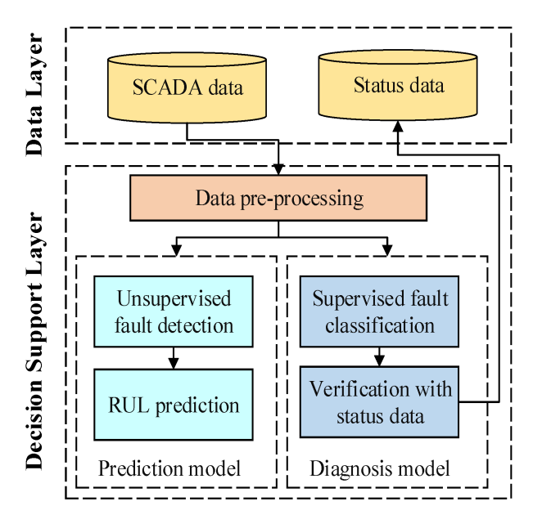
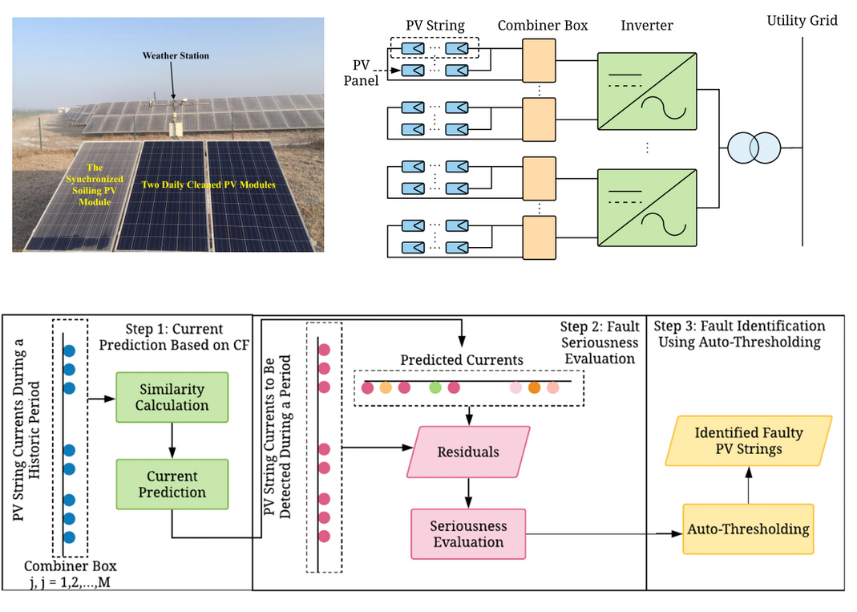
Anomaly Detection
Wind & solar farms
Ravi Starzl, PhD - Data Mining Fall 2023
Notes:
Anomaly detection in wind and solar farms is a critical application that ensures the efficient and safe operation of these renewable energy sources. By identifying irregularities or deviations from normal operating conditions, operators can address issues promptly to maintain optimal performance and prevent significant malfunctions or breakdowns. Here’s an overview of how anomaly detection is applied in wind and solar farms:
Wind Farms:
Monitoring Turbine Performance: Anomaly detection in wind farms often focuses on turbine performance. Sensors collect data on various parameters like vibration, temperature, rotor speed, and power output.
Predictive Maintenance: By analyzing this data, algorithms can identify patterns indicating potential problems, such as gear misalignment, bearing faults, or blade damage. Early detection of such anomalies allows for predictive maintenance, reducing downtime and repair costs.
Optimizing Energy Output: Anomalies in wind patterns or turbine response can also be detected to optimize the alignment and operation of turbines for maximum energy efficiency.
Solar Farms:
Panel Health Monitoring: In solar farms, anomaly detection involves monitoring the health and efficiency of solar panels. Parameters like energy output, panel temperature, and weather conditions are tracked.
Identifying Faults and Degradation: Anomalies may indicate panel faults, shading issues, or gradual degradation due to environmental factors. Early identification of these issues is key to maintaining high efficiency.
Weather Impact Analysis: Detecting and analyzing anomalies related to weather impacts, like dust accumulation or hail damage, helps in timely maintenance and decision-making.
Techniques Used:
Statistical Analysis and Machine Learning: These methods involve analyzing historical data to establish baseline performance and then identifying deviations. Machine learning models can learn complex patterns and predict potential failures.
Thermal Imaging and Drone Surveillance: These technologies are used for physical inspections to identify anomalies like hot spots in solar panels or structural issues in wind turbines.
Challenges:
Data Volume and Complexity: Wind and solar farms generate vast amounts of data, requiring robust algorithms for efficient processing.
Environmental Variability: The impact of varying environmental conditions on equipment performance adds complexity to anomaly detection.
Benefits and Future Applications:
Enhanced Efficiency and Reduced Costs: Timely detection and maintenance prevent costly breakdowns and enhance overall efficiency.
Integration with Smart Grids: Future applications may include more integrated approaches with smart grid technologies for optimized energy distribution based on real-time performance data.

Slide 16
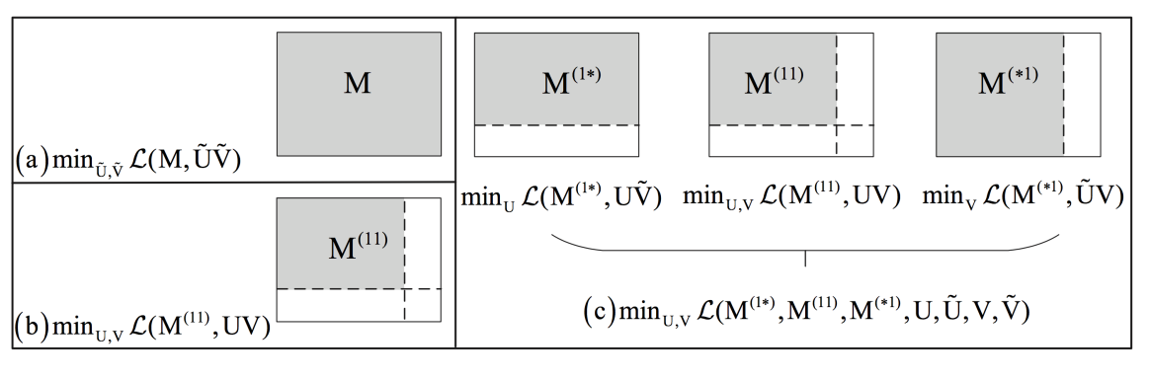
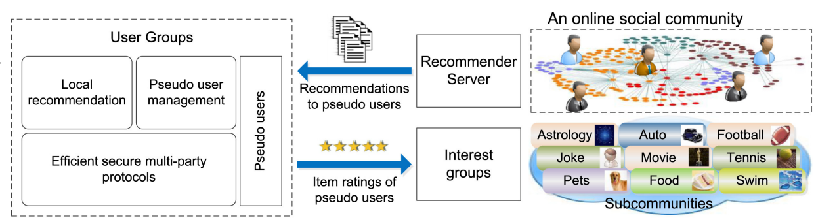
Recommendation
Online communities
Privacy-preserving
Matrix approximation (MA) based collaborative filtering (CF)
Weighted & ensemble MA
Mixture probabilistic MA
Global & local MA
Low-rank MA with stability
Expected risk minimization
Adaptive learning rate
Ravi Starzl, PhD - Data Mining Fall 2023
Notes:
In the context of providing recommendations for online communities while ensuring privacy preservation, various advanced techniques in Matrix Approximation (MA) based Collaborative Filtering (CF) can be employed. Here’s an overview of the recommended approaches and how they can be integrated into a robust recommendation system:
Weighted and Ensemble Matrix Approximation:
This approach involves giving different weights to different parts of the data, considering factors like recency or user activity level.
Ensemble techniques can combine multiple MA models, each trained on different aspects or segments of the data, to improve the accuracy and robustness of recommendations.
Mixture Probabilistic Matrix Approximation:
Implements a probabilistic framework in MA, allowing the model to handle uncertainty and variability in user preferences more effectively.
This approach is beneficial in diverse online communities where user preferences might not be uniformly distributed.
Global and Local Matrix Approximation:
Global MA provides recommendations based on the overall patterns in the data, suitable for capturing common preferences across the entire user base.
Local MA, in contrast, focuses on smaller user groups or individual preferences, offering more personalized recommendations.
Low-Rank Matrix Approximation with Stability:
Low-rank MA models simplify the user-item interaction matrix while preserving essential features, ensuring computational efficiency.
Incorporating stability in the model helps in dealing with sparse and noisy data, which is common in online communities.
Expected Risk Minimization:
This approach focuses on minimizing the expected risk or error in the recommendation predictions, leading to more reliable recommendations.
It balances the trade-off between model complexity and prediction accuracy, suitable for dynamic online communities where user interactions constantly evolve.
Adaptive Learning Rate:
Implementing an adaptive learning rate in MA-based CF allows the model to adjust its learning process based on the changing dynamics of user interactions and preferences.
This adaptability is crucial in online communities where trends and interests can shift rapidly.
Privacy-Preserving Techniques:
Ensuring privacy in recommendations involves techniques like differential privacy, where noise is added to the data or model to prevent the disclosure of individual user information.
Another method is federated learning, where the model is trained across multiple decentralized devices or servers holding local data samples, without exchanging them.

Slide 17
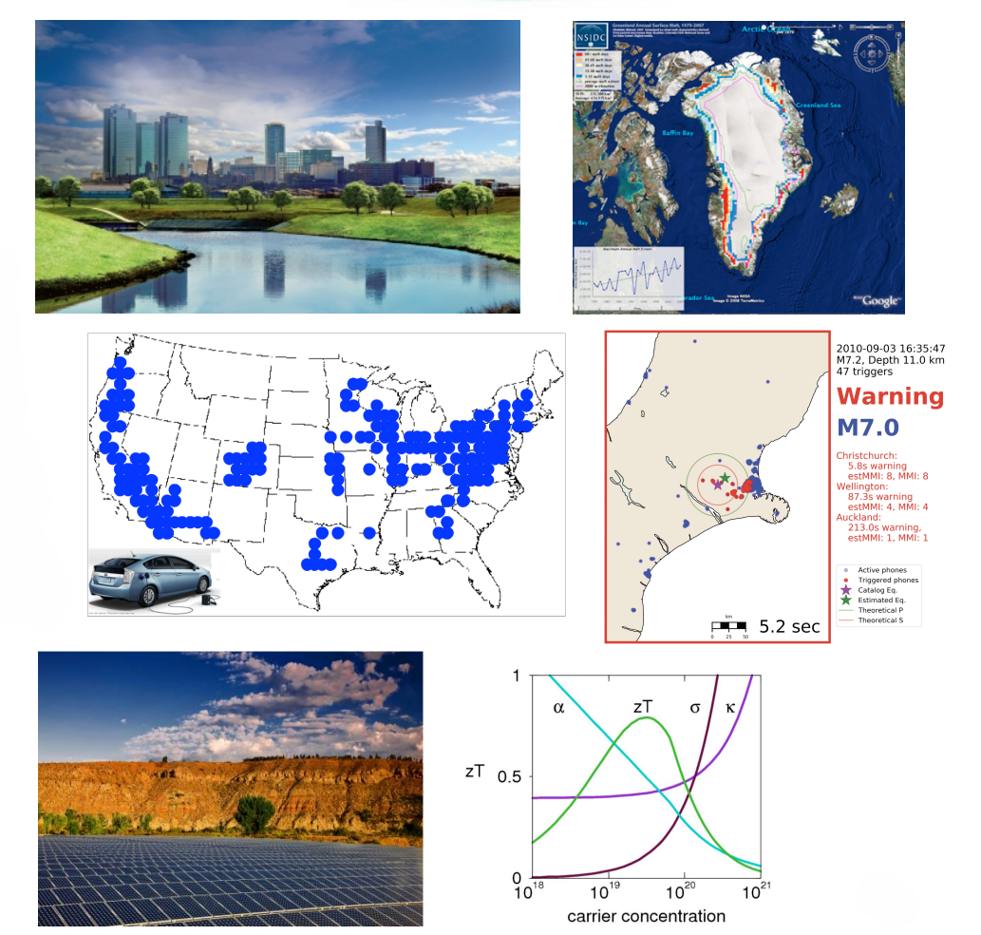
Data -driven Scientific Discovery
Environmental data analysis
Cryospheric data analysis
Transportation electrification
Solar/wind power, smart grids
Thermoelectric materials
Earthquake early warning
Notes:
Data-driven scientific discovery leverages large-scale data analysis to uncover new insights and make informed decisions in various scientific domains. Here's how data-driven approaches can be applied to the specific areas you mentioned:
Environmental Data Analysis:
Involves analyzing vast amounts of data from satellites, sensors, and field studies to understand environmental changes, biodiversity, climate patterns, and pollution levels.
Data-driven models can predict environmental trends, assess the impact of human activities on ecosystems, and inform conservation strategies.
Cryospheric Data Analysis:
Focuses on studying the Earth's frozen regions, including glaciers, ice caps, and permafrost, using remote sensing data and climate models.
Analyzing cryospheric data helps in understanding the impacts of climate change, such as ice melt rates, sea-level rise, and changes in polar ecosystems.
Transportation Electrification:
Data-driven approaches in transportation electrification involve analyzing traffic patterns, vehicle usage data, and charging infrastructure to optimize the deployment and operation of electric vehicles (EVs).
This analysis can inform policies for sustainable transportation, improve EV charging network designs, and enhance the efficiency of electric public transit systems.
Solar/Wind Power and Smart Grids:
In renewable energy, data analytics is used to optimize the performance of solar and wind farms, predicting energy output based on weather patterns and managing grid integration.
Smart grids leverage data from various sources, including energy consumption patterns and renewable energy availability, to efficiently distribute energy and integrate renewable sources.
Thermoelectric Materials:
Data-driven research in thermoelectric materials involves using computational methods to discover and optimize materials that can efficiently convert heat into electricity.
Machine learning models can predict the thermoelectric properties of materials, accelerating the discovery of new materials for energy applications.
Earthquake Early Warning:
Data-driven approaches in earthquake science involve analyzing seismic data to provide early warnings of earthquakes. This includes detecting primary waves (P-waves) which travel faster and arrive before the more destructive secondary waves (S-waves).
Real-time data processing and predictive analytics can enhance the accuracy of early warning systems, providing crucial time for people to take protective actions.

Slide 18
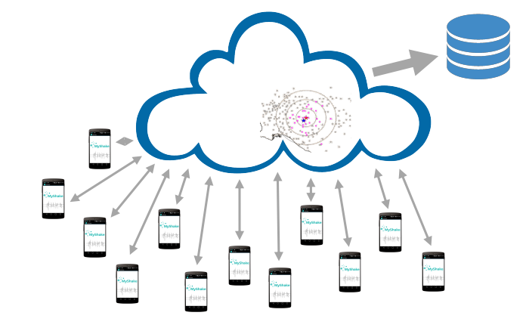
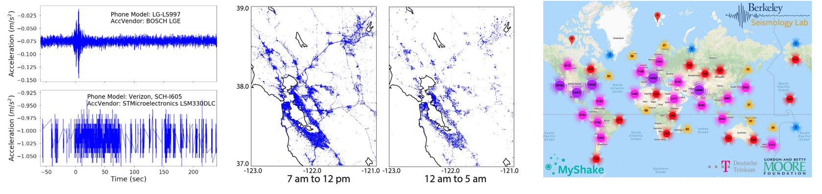
Earthquake Early Warning
MyShake: 320K downloads, 40K active users
Hardware heterogeneity
Dynamic network: spatial, temporal
Notes:
The MyShake project, an earthquake early warning system utilizing a mobile app, demonstrates the innovative use of widespread technology for seismic monitoring. With its substantial number of downloads and active users, MyShake harnesses the power of crowd-sourced data, but it also faces challenges such as hardware heterogeneity and the dynamic nature of its network. Here's an overview:
MyShake's User Base:
With 320,000 downloads and 40,000 active users, MyShake has a vast and diverse user base. This scale provides a significant amount of data, crucial for detecting and analyzing seismic activity.
The participation of a large number of users across different regions enhances the system’s ability to monitor and provide early warnings of earthquakes over a wide geographical area.
Hardware Heterogeneity:
The users of MyShake use a variety of smartphones with different hardware capabilities, leading to heterogeneity in the data quality and sensitivity of the seismic readings.
This diversity requires sophisticated algorithms to normalize and interpret the data accurately, ensuring that the seismic activity is correctly identified across different devices.
Dynamic Network: Spatial and Temporal Aspects:
MyShake operates as a dynamic network, both spatially and temporally. Users’ locations change as they move, and their activity patterns vary, affecting the availability and distribution of data over time and space.
Managing this dynamic network involves continuously adapting to changes in data availability and user distribution, which is vital for maintaining the system's effectiveness and reliability.
Seismic Data Analysis:
The app utilizes the accelerometers in smartphones to detect ground motion. The data collected from multiple users is then analyzed to distinguish between earthquake tremors and non-seismic activities (like everyday phone movements).
Aggregating and analyzing data from thousands of users allows the system to rapidly detect earthquakes and issue warnings to users in the affected area before the more damaging secondary waves (S-waves) arrive.
Challenges in Earthquake Detection:
One of the main challenges is minimizing false alarms while ensuring timely and accurate detection of real seismic events.
Another challenge is ensuring the system’s resilience and reliability, especially during high-demand scenarios, like immediately following a significant earthquake.
Future Enhancements:
Continued growth in the user base can improve the system's sensitivity and coverage.
Advances in data processing, machine learning, and user engagement strategies can further enhance the system's accuracy and responsiveness.

Slide 19
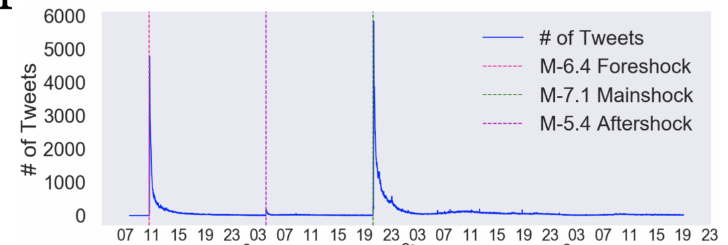
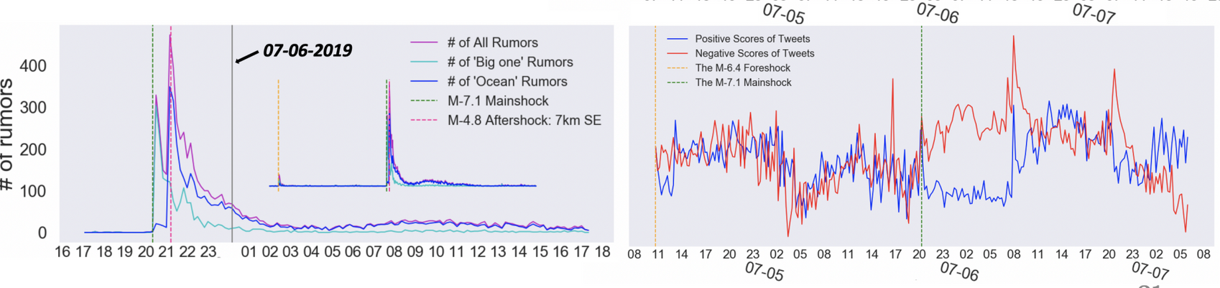
Earthquake Public Response
2019 Ridgecrest Earthquakes
Key Twitter accounts
Emotions, topics, rumors
Notes:
The public response to the 2019 Ridgecrest Earthquakes, particularly through platforms like Twitter, offers a valuable case study in understanding how people react and communicate during seismic events. Analyzing key Twitter accounts, emotions, topics, and the spread of rumors during this period can provide insights into public sentiment and information dissemination. Here's an overview:
Key Twitter Accounts:
During the Ridgecrest Earthquakes, certain Twitter accounts, such as those of local and state emergency services, news outlets, and seismologists, played pivotal roles in disseminating information.
These accounts often provide real-time updates, safety instructions, and clarification on seismic activities.
Emotions Expressed on Twitter:
The analysis of tweets from the affected area can reveal a range of emotions, including fear, anxiety, relief, and solidarity.
Emotional responses on social media can influence public perception and reactions to the ongoing crisis.
Topics Discussed:
Common topics during such events include the intensity and location of the earthquakes, damage reports, aftershock warnings, and emergency contact information.
Discussions may also focus on personal experiences, safety check-ins, and community support initiatives.
Rumors and Misinformation:
In the immediate aftermath of an earthquake, social media can sometimes become a breeding ground for rumors and misinformation, such as exaggerated damage reports or unfounded predictions of future quakes.
Monitoring and addressing these rumors swiftly is crucial to prevent panic and ensure the public receives accurate information.
Data Analysis Techniques:
Sentiment analysis, topic modeling, and social network analysis are useful techniques for analyzing Twitter data to understand public response patterns.
These techniques can identify prevalent sentiments, common topics, key influencers, and the spread of information or misinformation.
Lessons Learned:
Studying social media responses to events like the Ridgecrest Earthquakes helps in improving emergency communication strategies and public preparedness plans.
It also highlights the importance of credible sources and the need for effective communication channels during emergencies.
Future Implications:
Insights gained from social media analysis can inform future earthquake response strategies, both in terms of emergency services and in public communication.
It also underscores the evolving role of social media as a critical tool in disaster response and public safety communication.

Slide 20
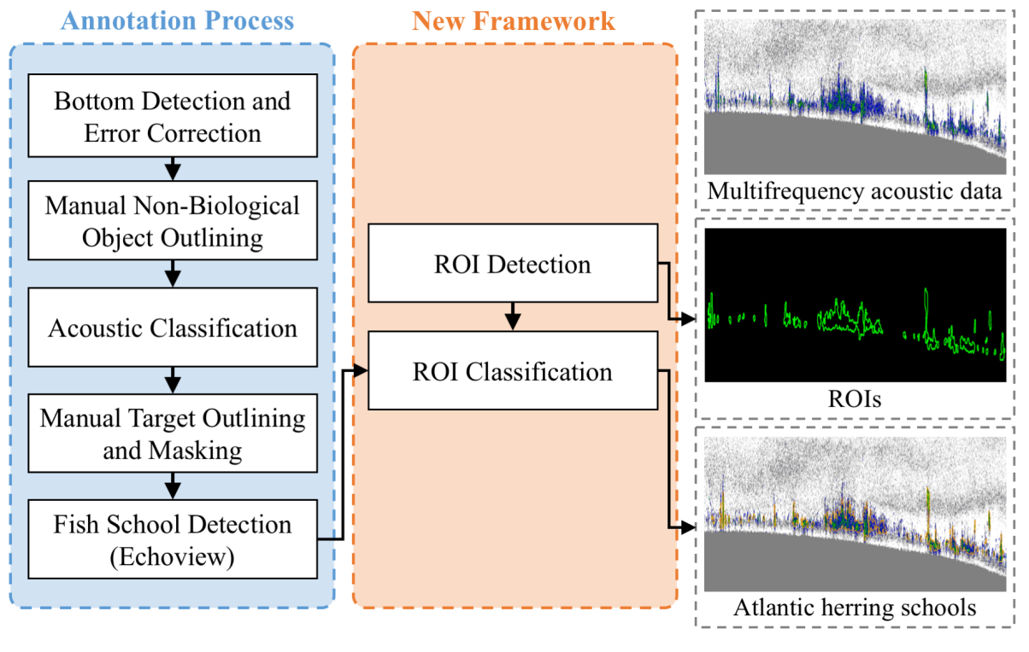
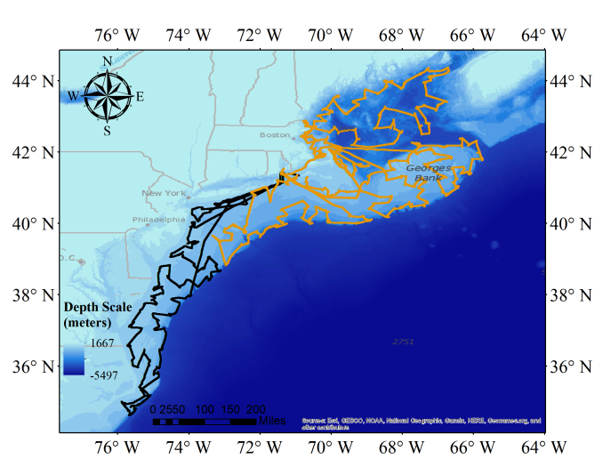
Acoustic Fisheries Data Analysis
Fish school detection
Notes:
Acoustic Fisheries Data Analysis, particularly for fish school detection, involves using sonar (Sound Navigation and Ranging) technology to locate and quantify fish populations. This method is pivotal in modern fisheries management and marine research. Here’s an overview of how it works and its applications:
Technology Behind Acoustic Data Analysis:
Sonar devices emit sound waves that travel through water. When these waves encounter objects like fish, they are reflected back to the device.
The reflected sound waves (echoes) are analyzed to determine the location, size, and composition of fish schools.
Fish School Detection:
Acoustic data analysis enables the detection of fish schools by interpreting the characteristics of the sonar echoes.
Characteristics like the strength and shape of the echo signal can indicate the presence of a fish school, its density, and even the types of fish present.
Applications in Fisheries Management:
Stock Assessment: Acoustic surveys are used to estimate the abundance and distribution of fish stocks, crucial for sustainable fisheries management.
Behavioral Studies: They help in understanding the behavior patterns of fish, such as spawning and feeding habits.
Habitat Monitoring: Understanding how fish interact with their habitats and the impact of environmental changes on fish populations.
Advantages of Acoustic Methods:
Non-invasive and less disruptive compared to traditional fish-catching methods used for stock assessment.
Provides real-time data and can cover large areas, making it efficient for monitoring expansive marine environments.
Challenges in Data Analysis:
Interpreting sonar data requires expertise, as various factors like water depth, temperature, and bottom composition can affect echo readings.
Differentiating between species and sizes of fish based on acoustic data can be challenging and often requires supplementary data for accuracy.
Integration with Other Technologies:
Combining acoustic data with other technologies like satellite imagery, environmental sensors, and GPS can provide a more comprehensive understanding of marine ecosystems.
Advances in data processing and machine learning are enhancing the analysis of acoustic data, enabling more accurate and detailed fishery assessments.
Future Directions:
Ongoing advancements in sensor technology, data analytics, and artificial intelligence are expected to further improve the accuracy and scope of acoustic fisheries data analysis.
Enhanced data analysis capabilities will support more effective and responsive fisheries management strategies, contributing to the conservation of marine ecosystems.

Slide 21

NSF ASPIRE ERC
Mission: Sustainable and equitable future for transportation
Vision : Wide -spread electrification of all vehicle classes; ubiquitous, shared public charging infrastructure
Notes:
The NSF ASPIRE ERC (Engineering Research Center) focuses on a transformative approach to transportation, aligning with a mission and vision aimed at creating a sustainable and equitable future. Here’s an overview of its key objectives:
Mission: Sustainable and Equitable Future for Transportation:
The mission is centered around revolutionizing transportation systems to be more sustainable, reducing environmental impacts such as carbon emissions and pollution.
It also emphasizes equity, ensuring that advancements in transportation technology are accessible and beneficial to all segments of society, regardless of geographic or economic status.
Vision: Electrification of All Vehicle Classes and Public Charging Infrastructure:
The vision includes widespread electrification across all vehicle classes, from personal cars to public transit and commercial vehicles. This shift is crucial for reducing dependence on fossil fuels.
Another aspect of the vision is developing a ubiquitous and shared public charging infrastructure. This infrastructure would support the widespread adoption of electric vehicles (EVs) by ensuring convenient and reliable access to charging facilities.
Research and Innovation:
The center is likely involved in cutting-edge research and development activities to advance EV technologies, including improvements in battery systems, electric powertrains, and charging technologies.
Innovation in smart grid integration and renewable energy sources to power the charging infrastructure is also a key focus.
Collaboration and Partnerships:
The center probably collaborates with various stakeholders, including academic institutions, industry partners, government agencies, and community organizations, to drive forward its mission and vision.
These collaborations are essential for pooling expertise, resources, and perspectives to address the multifaceted challenges of transportation electrification.
Education and Workforce Development:
A critical component of the center’s work is likely education and workforce development, preparing a new generation of engineers and professionals equipped to contribute to sustainable transportation solutions.
This may include interdisciplinary educational programs, hands-on research opportunities, and community outreach to inspire and engage diverse talent in this field.
Policy and Community Engagement:
Engaging with policymakers to inform and shape regulations and policies that support the transition to electrified, sustainable transportation is likely an important aspect of the center’s work.
Community engagement initiatives may focus on raising public awareness, understanding community needs, and ensuring that the benefits of transportation electrification are shared equitably.

Slide 22
Thank you
A special thank you to Qin Lv for her slides, on which this lecture is based
Ravi Starzl, PhD - Data Mining Fall 2023

